Slide 1
A genetic algorithm to achieve scheduling flexibility
Journées FRO/PM20 à l’École Polytechnique de Tours
13,14 novembre 2003
Mohamed Ali ALOULOU ⁽¹⁾⁽²⁾ & Marie-Claude PORTMANN ⁽¹⁾
⁽¹⁾ MACSI Team of LORIA & INRIA Lorraine
⁽²⁾ SYSDEF - LIP6

Slide 2
Context : European Groth project V-CHAIN
Delivery lateness
Internal
suppliers
Internal
customers
Principal components
Assembly line
Due dates
Secondary components
External
suppliers
External
customers
breakdowns
Delivery lateness
Storage cost
 Schedule the assembly line
 Plan secondary component’s arrival
● Provide delivery dates

Slide 3
Scheduling in the presence of uncertainty
Davenport & Beck (2000) and Herroelen and Leus (2003)
Totally unknown uncertainty
Partially known uncertainty
Totally reactive approaches
Proactive (or robust) approaches
Predictive-reactive approaches
Proactive-reactive approaches

Slide 4
A proactive-reactive approach
Key idea : Anticipate the presence of disruptions by introducing some flexibility in the solution computed off-line
Production plan
PROACTIVE ALGORITHM
Flexible solution
=
Set of schedules
The flexible solution in use is infeasible
REACTIVE ALGORITHM
On-line decisions
Shop state follow-up
shop

Slide 5

Methodology
Definition phase
  Definition of the problem and its environement
  What is a flexible solution to the problem ?
  How to measure a solution quality ?
Implementation phase
  Proactive algorithm
    Solutions with a good tradeoff between the quality measures
  Reactive algorithm
    Control the shop on-line

Slide 6
Definition of the problem
Single machine problem 1|prec, r_{j}|(∑w_{j}T_{j}, C_{max})
  Dynamic job arrival (r_{j} ) : principal components
  Imperative precedence constraints (prec)
  Total weighted tardiness (∑w_{j}T_{j}) and makespan (C_{max}) as objective functions
Possible perturbations
  Principal and secondary component’s availability, and/or
  Tools availability, and/or
  Machine breakdowns
  No more data is given

Slide 7
Definition of a flexible solution
A flexible solution
A partial order between the jobs
A schedule type
(semi-active, active or non delay)
2
1
3
5
6
4
7
1 → 2 → 3 → 4 → 6 → 7 → 5
On-line scheduling decisions

Slide 8
Flexibility types in scheduling
GOTHA- Research group on flexibility in scheduling
Job i starts at 8h30 ⇒ No flexibility
i
k
i
t_{i}
k
i
r_{k}
Time flexibility
Flexibility in job sequencing
i
k
i
M1
M1
M2
M3
i
M2
M1
M3
M2
Ressource flexibility
Production flexibility

Slide 9
Example
4 jobs s.t. r₁=r₃=0, r₂= 1, r₄=9 ; p₁=p₂=3, p₃=2, p₄=2 ; d₁=6, d₂=8, d₃=9, d₄=12 ; w_{i}=1 ;
S₁
1
2
3
4
C_{max}(S₁)= C_{max}(S₂)=11
WT(S₁)= WT(S₂)=0
r₄=9
WC_{max} = 11 ; WWT =0 ;
S₂
1
3
2
4
3
r₄=9
ND
C_{max}(S₃) =11
WT(S₃)=1
1
S₃
2
1
3
4
4
WC_{max} = 11 ;
WWT =1 ;
r₂=1
d₁=6
r₄=9
A
2
S₄
1
2
4
3
C_{max}(S₄)= C_{max}(S₅)=13
WT(S₄)= 4 ;WT(S₅)=5
r₄=9
S₅
2
1
4
3
WC_{max} = 13 ; WWT =5 ;
r₂=1
r₄=9
SA

Slide 10
Quality of a solution
The quality of a solution depends
  Objectives function values of the represented schedules
  Number of the represented schedules
  Time interval forecasted for scheduling the whole set of tasks (WC_{max})
Performance
of a solution
Flexibility in
job sequencing
Flexibility
in time

Slide 11
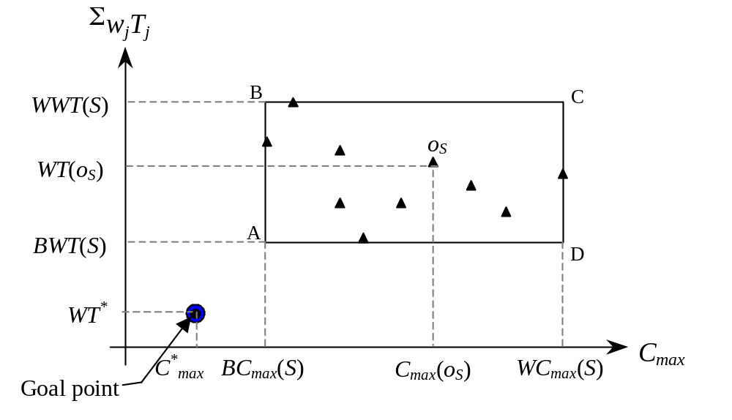
Performance of a solution
Minimization problems
1|prec, r_{j}|C_{max}
1|prec, r_{j}|Σw_{j}T_{j}
Maximisation problems
1(sa)|prec, r_{j}|(C_{max}→max)
1(sa)|prec, r_{j}|(Σw_{j}T_{j} → max)
It is not also possible to calculate all schedules o_{S} represented by S
We limit our selves to the most representative schedules

Slide 12
Flexibility of a solution (1)
Flexibility in job sequencing
  First measure : number of represented schedules
    The problem of computing this number is #P-complete
  Second measure : number of non-oriented or « free edges » in the transitive graph
2
F_{seq} = 5/15
1
3
5
6
4
7
  Transformation in a qualitative scale
    Levels of flexibility Ni characterized by [nbEdgeMin_{Ni}, nbEdgeMax_{Ni}]
Very low
flexibility
Low
flexibility
Middle
flexibility
High
flexibility
Very high
flexibility
Nombre
of edges
0/21
3/21
7/21
13/21
17/21
21/21

Slide 13
Flexibility of a solution (2)
Flexibility in time
  is provided according to the time window in which the jobs can be executed
  A global measure : (WC_{max}-P)/P
    WC_{max} the worst C_{max}
    P : total processing time

Slide 14
Implementation of the proactive reactive approach
Evaluation module
  Complexity results
  Heuristic approaches
Interactive module to compute proactive solutions
  Good tradeoff between flexibility and performance measures
On-line control module (reactive algorithm)
  Guide the execution when there is no disruption
  Make corrective decisions in the presence of disruptions
  Detect when the solution in use becomes « bad »

Slide 15
Proactive algorithm (1)
Multi-objective problem
  Minimize the distance Ds (function of BWT, WWT, BC_{max} …)
  Maximize the flexibility in job sequencing (number of « free edges »)
  Maximize the flexibility in time (function of WC_{max})
Principle of the algorithm
  Transform the problem to several mono-objective problems
    Minimize OF = θ Ds - (1-θ) F_{time}, θ ∈[0,1]
  Solve each problem on a different search space
    A search space = { Solutions belonging to a level of flexibility in job sequencing defined by [nbEdgeMin_{Ni}, nbEdgeMax_{Ni}] }

Slide 16
Proactive algorithm (2)
Flexibility
level N1
Flexibility
level N2
Flexibility
level Nm
GA
GA
…
GA
θ∈[0,1]
θ∈[0,1]
θ∈[0,1]
BEST_{N1,θ}
BEST_{N2,θ}
BEST_{Nm,θ}
Decision maker
Choice of a solution (partial order)

Slide 17
General scheme of a GA
Generate an initial popultation P₀
Select N_{pop} couples of
chromosomes for reproduction
Evaluate
and
Update BEST_{Nl,θ}
Cross the selected couples
Mutate some children (π_{mut})
Select, from Pi and the generated
children, N_{pop} chromosomes for survival
BEST_{Nl,θ}

Slide 18
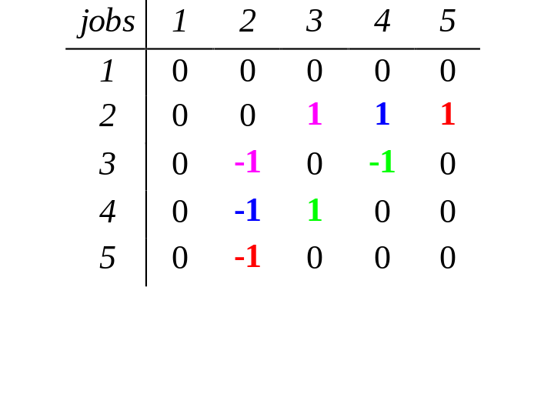
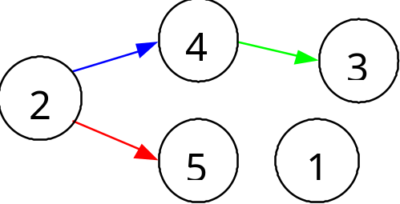
Implementation of a GA
Encoding :
Crossover and Mutation should provide chromosomes
  Satisfying imperative precedence constraints
  Belonging to the considered level of flexibility Nl
Partial order
Ternary precedence constraints matrix A

Slide 19
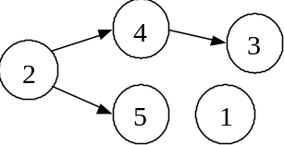
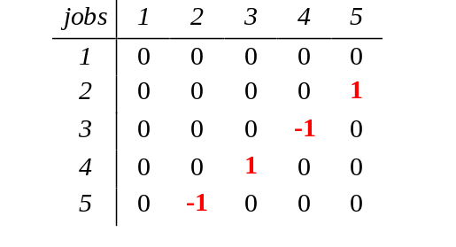
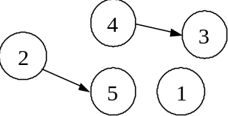
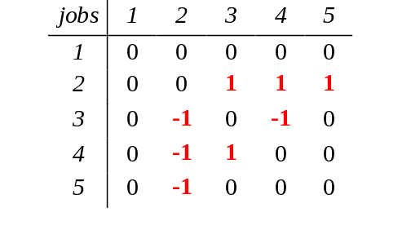
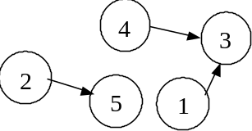
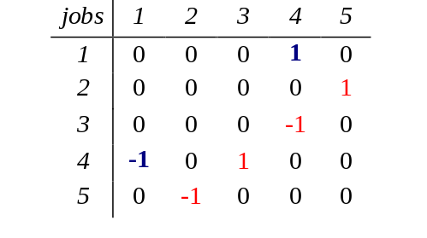
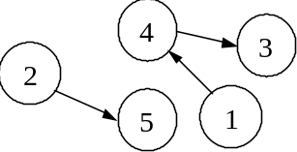
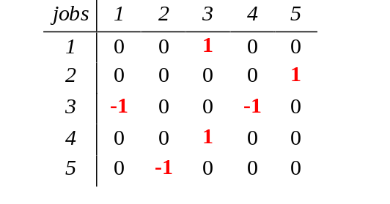
Crossover
Mate 1
nbArcs = 4
First step: (A1+A2)/2
nbArcs = 2
A1
Second step: Generate the offspring
Mate 2
nbArcs = 3
nbArcs = 4
A2
Caution: Do not forget to compute the transitive closure of A

Slide 20
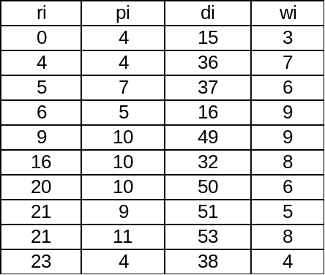
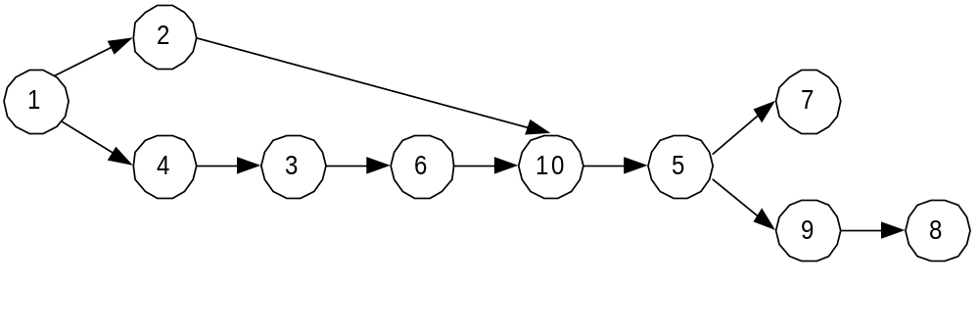
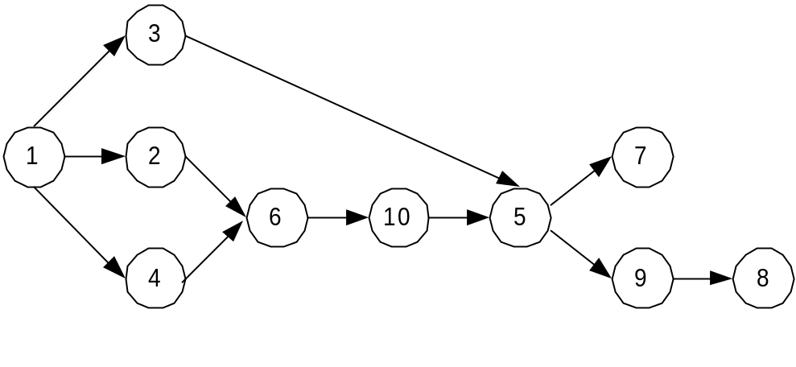
Examples of obtained solutions
Solution 1:
Flex_{seq}=5/45=11%
Problem
BC_{max}=74 and WC_{max}=76
BWT= WT* = 221 and WWT= 273 = 1.24 WT*
Flex_{time}= 2/74
Solution 2:
Flex_{seq}=7/45=15,5%
BC_{max}=74
WC_{max}= 97
WT* = 221
WWT = 2210 = 10 WT*
BC_{max}=74 and WC_{max}=77
BWT= WT* = 221 and WWT= 299 = 1.36 WT*
Flex_{time}= 3/74

Slide 21
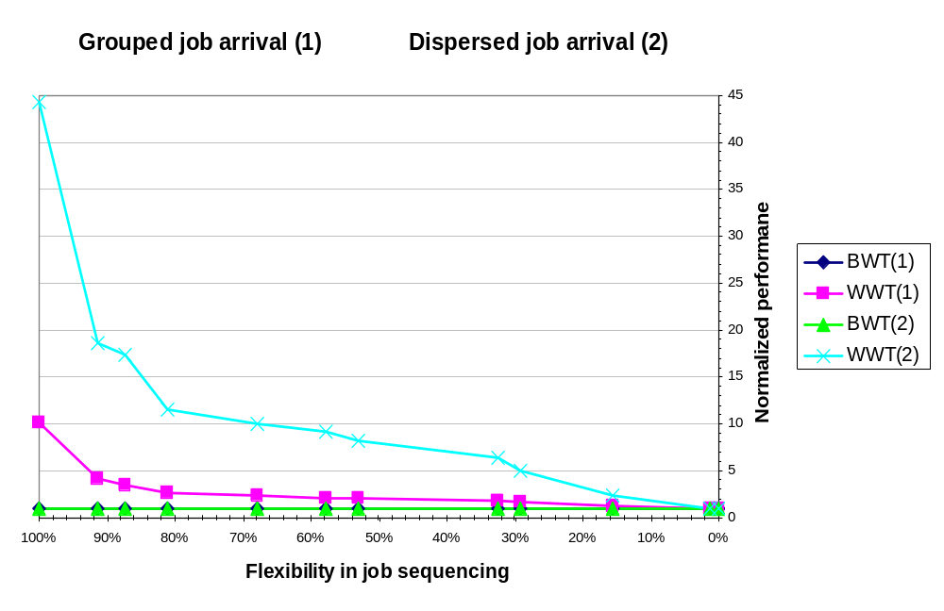
Experimentation of the proactive algorithm
230 free edges
WWT(1)=1.7
130 free edges
WWT(1)=1.3
WWT(2)=2.9

Slide 22
Reactive algorithm
Guide the execution when there is no disruption
  Offer every time a decision should be taken more than one alternative
  Keep the flexibility in time to be used when a breakdown occurs
  Obtain good performance when no disruption occurs
Make corrective decisions in the presence of disruptions
Detect when the solution in use becomes bad

Slide 23
A posteriori quality measures (1)
Flexibility
F_{seq}(S)=6
Available
jobs
Algorithm P1
Available
jobs
Algorithm P2
5
3
2
4
5
3
2
5
1
1
1
1
3
1
2
4
4
3
2
4
5
1
3
sequence
1
2
5
4
3
sequence
F_{flex}(S,P1)=100%
F_{flex}(S,P2)=33%
F_{flex}(S,P)=(number of alternatives – n)/F_{seq}(S)

Slide 24
A posteriori quality measures (1)
Performance
  Makespan F¹_{perf} = (C_{max}(S,P)-BC_{max}(S))/BC_{max}(S)
  Tardiness F²_{perf} = (WT(S,P)-BWT(S))/BWT(S)

Slide 25
On-line algorithms
Simple algorithms based on priority rules
  To maximize the use of flexibility in job sequencing
    Choose the available task that has the maximum number of successors
    Choose the available task that keeps the maximum number of « free edges »
  To minimize F¹_{perf} (makespan)
    Constuct non-delay schedules
  To minimize F²_{perf} (tardiness)
    ATC, X-RM rules

Slide 26
Global experimentations
Comparison with a predictive-reactive approach
Predictive solutions are given equivalent flexibility in time in average (the same storage cost of secondary components)
The proactive-reactive approach outperforms the predictive-reactive approach for low and medium disruption amplitude

Slide 27
Conclusion
A proactive algorithm that uses explicitely
  Flexibility measures
  Performance measure
Immediate extension to flow shop problems
Ressource flexibility
  How to model a solution that represents ressource flexibility ?
  How to evaluate it ?
  How to compute it ?
How to handle demand uncertainty ?

